Slide 1

Case Study: Diabetes Diagnosis
Professor Bo Liu
James Watt School of Engineering

Slide 2
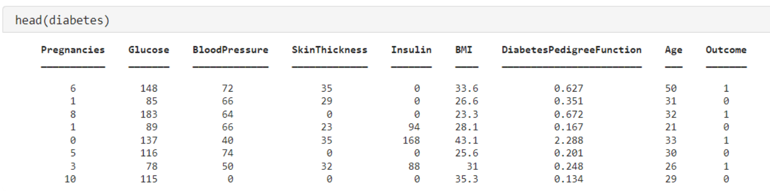
Problem background and dataset description
Diabetes diagnosis (classification)
This problem has the following inputs:
Number of pregnancy.
Glucose.
Blood pressure.
Skin thickness.
The only output is:
diabetes diagnosis (binary).
Related functions:
head
Insulin.
BMI.
Diabetes pedigree function.
Age
See live script

Slide 3
Re-arranging dataset
Diabetes diagnosis (classification)
This problem has the following inputs:
Number of pregnancy.
Glucose.
Blood pressure.
Skin thickness.
The only output is:
diabetes diagnosis (binary).
Related functions:
dividerand
insulin.
BMI.
Diabetes pedigree function.
Age
% Spliting the dataset
[trainInd,valInd,testInd] = dividerand(size(diabetes,1), 0.7, 0.15, 0.15);
tblTrain = diabetes(trainInd,:); % Extracting training sample inputs
tblValid = diabetes(valInd,:); % Extracting validation sample inputs
tblTest = diabetes(testInd,:); % Extracting testing sample inputs
See live script

Slide 4
Construction and training of the network
Neural network construction and configuration
layers = [
featureInputLayer(size(tblTrain,2)-1,"Normalization","rescale-zero-one")
fullyConnectedLayer(40) % increased hidden layer neurons
reluLayer % ReLU activation func. (not a new layer of neurons)
fullyConnectedLayer(40) % additional hidden layer
reluLayer % ReLU activation func. (not a new layer of neurons)
fullyConnectedLayer(numClasses) % Output layer: # output dim.
softmaxLayer % softmax layer for classification
classificationLayer("Name","output")];
Useful docs:
deep learning layers
Adam optimizer
Related functions:
featureInputLayer
softmax
reluLayer
fullyConnectedLayer
classificationLayer
trainingOptions
trainNetwork
options = trainingOptions('adam', ... % using adam optimizer
'MaxEpochs',6000, ... % number of epochs of training
'MiniBatchSize', size(tblTrain,1), ... % batch training
'L2Regularization', 1e-3, ... % L2 Regularization
'Shuffle','every-epoch', ... % shuffling the training samples
'ValidationFrequency',40, ... % Computing validation accuracy every 40 epoch
'ValidationPatience',20, ... % Stop the training if acc not improve for 20 valid
'ValidationData', tblValid, ... % Validation set
'Plots','training-progress', ... % visualizing the training process
'ExecutionEnvironment', 'cpu', ... % training on CPU
'Verbose',false); % hide notice while training
Neural network training
net = trainNetwork(tblTrain, layers, options);
See live script

Slide 5
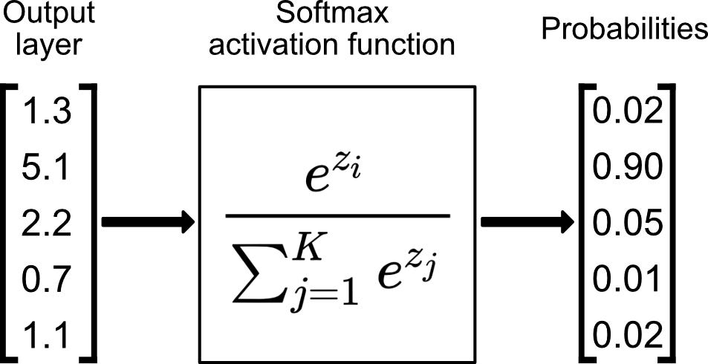

Construction and training of the network
fullyConnectedLayer(40) % additional hidden layer
reluLayer % ReLU activation func. (not a new layer of neurons)
fullyConnectedLayer(numClasses) % Output layer: # output dim.
softmaxLayer % softmax layer for classification
classificationLayer("Name","output")];
Related functions:
softmax
Vector of values
(regression outputs)
Vector of probabilities
E.g., network outputs 5 values for a 5-class classification
z
Choose the one with max probability

Slide 6
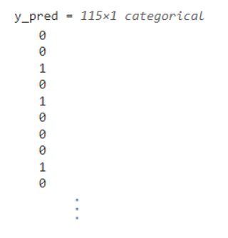

Prediction using the neural network
% Predicting test set
y_pred = predict(net, tblTest,'ReturnCategorical',1)
Related functions:
predict
categorical
% number of correct predictions
acc_temp = nnz(y_pred(:,1) == tblTest.Outcome);
acc = acc_temp ./ size(tblTest.Outcome, 1)
See live script

Slide 7
Network construction guideline recap
For simple tasks: start with simple structures
1 or 2 hidden layers.
Number of neurons: two times number of inputs, or multiple tens, in each layer.
ReLU / tanh / sigmoid activation.
regression output layer, for regression task.
softmax output layer, for classification task.
Tuning structure for the better performance:
More layers.
More neurons in each layer.
Normalization layers.
Switch activation functions.
Change batch size. etc

Slide 8




Thanks!
#UofGWorldChangers
@UofGlasgow

